Slide 1

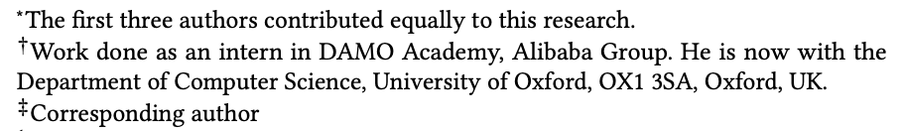
DCdetector: Dual Attention Contrastive Representation Learning
for Time Series Anomaly Detection
(KDD 2023 research track)
Yiyuan Yang^{1∗†}, Chaoli Zhang^{2∗}, Tian Zhou^{2∗}, Qingsong Wen^{2 ‡}, Liang Sun²
1Department of Computer Science, University of Oxford, 2DAMO Academy, Alibaba Group
yiyuan.yang@cs.ox.ac.uk, {chaoli.zcl, tian.zt, qingsong.wen, liang.sun}@alibaba-inc.com

Slide 2
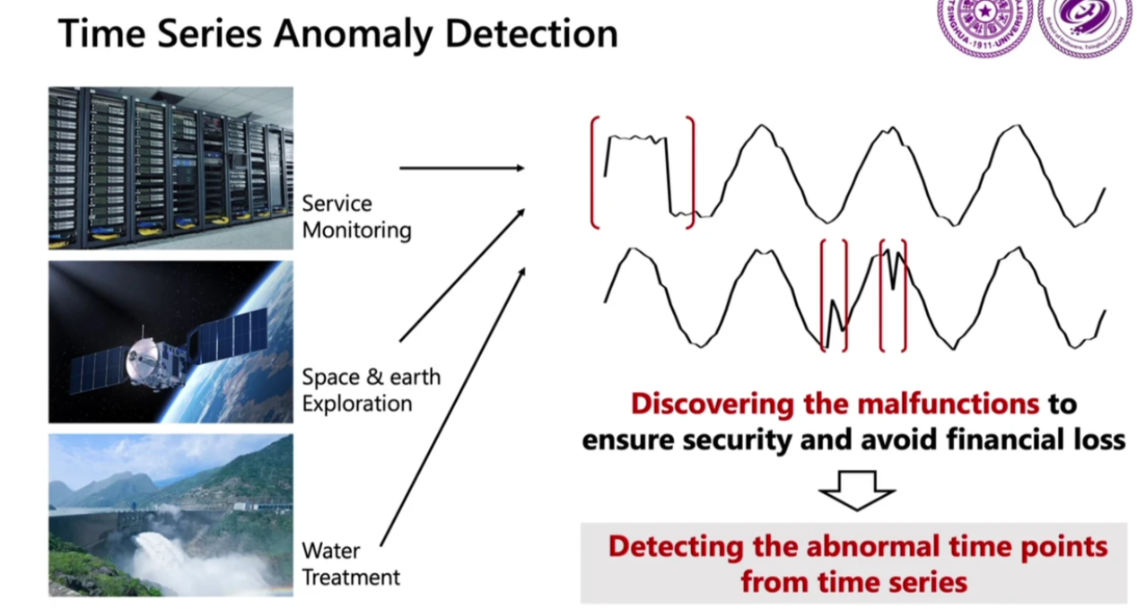
Background: Time Series Anomaly Detection
Detecting the abnormal time-step from the original time-series.
Extracting useful information from the time-series to ensure security, avoid financial loss and so on.
Notes:
First of all, I’d like to introduce some background

Slide 3
Challenges: Time Series Anomaly Detection
Lack of Labeled Data: Anomalies are usually rare without many labels. Systems are in steady state in majority of cases.
Imbalance: The number of anomalies is much smaller than the normal one. For example, in the financial system.
Noise Interference: Time-series data may be affected by noise that may mask the true anomaly signal.
Complex Patterns: Typical anomalies are often complex (e.g., wind turbines operate in different modes and conditions).
Multi-dimensional Features: Models should consider temporal, multidimensional and non-stationary characteristics.
Explanatory and Interpretable: In some application scenarios, explanatory and interpretable results for anomaly detection are needed to better understand why an anomaly was flagged and to be able to take action accordingly.
Anomaly detection based on unsupervised learning (learning without labeled data)
time series data
Per timestamp feature mining
Anomaly detection, evaluation at each timestamp

Slide 4
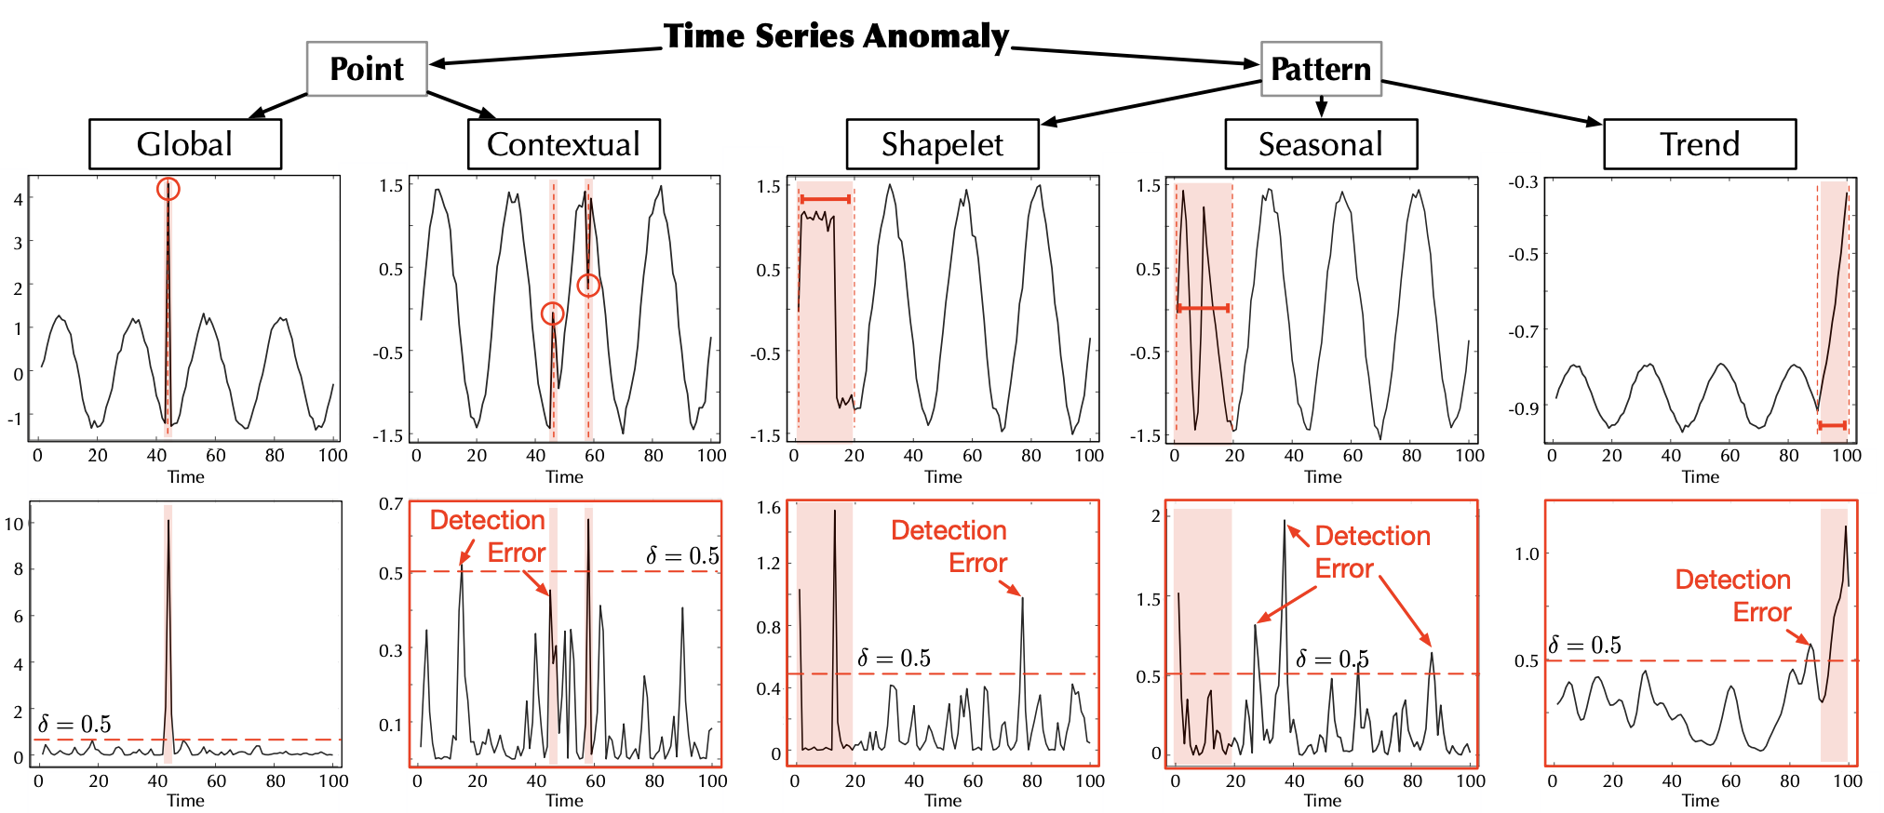
Challenges of time series anomaly detection
Illustration of the challenges: 1, Numerous complex patterns in time series; 2 Different types of anomalies
Input time series
Anomaly score
Xu J, Wu H, Wang J, Long M. Anomaly transformer: Time series anomaly detection with association discrepancy. ICLR’22

Slide 5
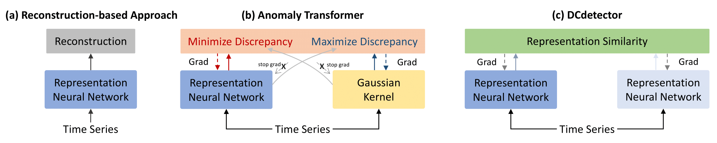
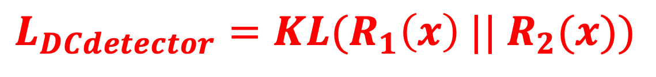
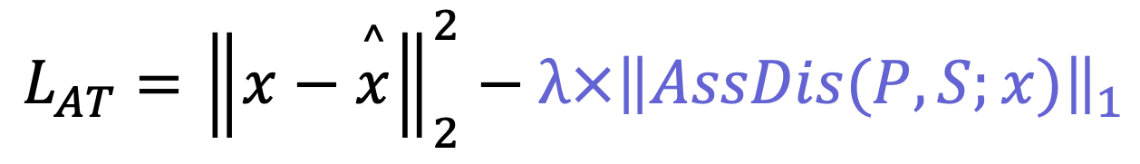
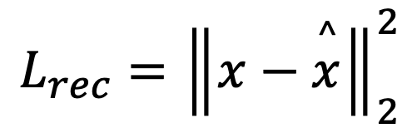
Related work: previous SOTA methods vs. DCdetector
minmax
$$L_{rec}={\left\|x−\overset{^}{x}\right\|}_{2}^{2}$$
$$L_{AT}={\left\|x−\overset{^}{x}\right\|}_{2}^{2}−λ×{\left\|AssDis(P,S;x)\right\|}_{1}$$
$$L_{DCdetector}=KL(R_{1}\left(x\right) ||{ R}_{2}(x))$$
Reconstructed-based problem: The raw time series has a mixture of normalities and anomalies with noise.
So it is difficult to train a high quality encoder for reconstruction based models.
Highlight: DCdetector is concise with pure contrastive structure without reconstruction and minmax learning

Slide 6
Method: DCdetector’s Intuition
An intuition:
Observation: normal points are closely related to other adjacent sample points, while abnormal points are discrete from others.
Design Principle: by constructing different representations (patch-wise and in-patch) between the sample points, if the similarity of the different representations is high, it means that they are normal points.
{ }
{ }
Normal point: Strong relation between adjacent data
Anomaly: Weak relation between adjacent data
Differentiation by similarity of the different representations
Notes:
、

Slide 7
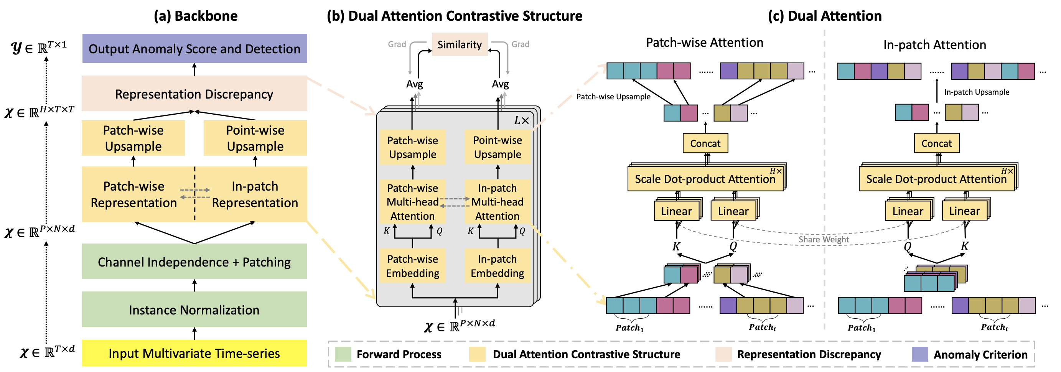
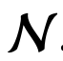

Method: DCdetector's Framework: 4 components
Notes:
、

Slide 8
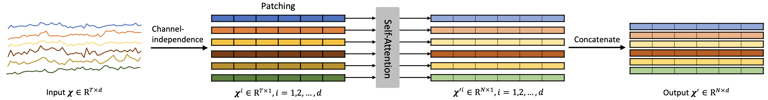
Method: DCdetector's Framework - Forward Process (1/4)
Instance normalization (tackle non-stationarity problem)
Patching and channel independence (tackle temporal dependency and multidimensional problems)
Notes:
、

Slide 9
Method: DCdetector's Framework – Dual Attention Contrastive Structure (2/4)
Two branches as permutated multi-view representations:
Patch-wise representation: Attention scores between different patches
In-patch representation: Attention scores of internal patch
Asymmetric design: avoid model collapse and trivial solution in
Inductive bias: normal points can maintain their representation under permutations while the anomalies can not

Slide 10
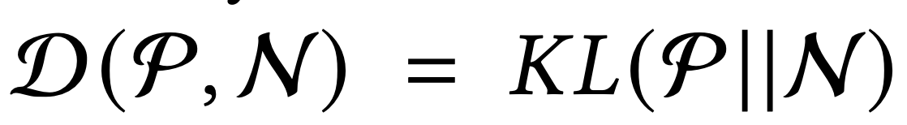
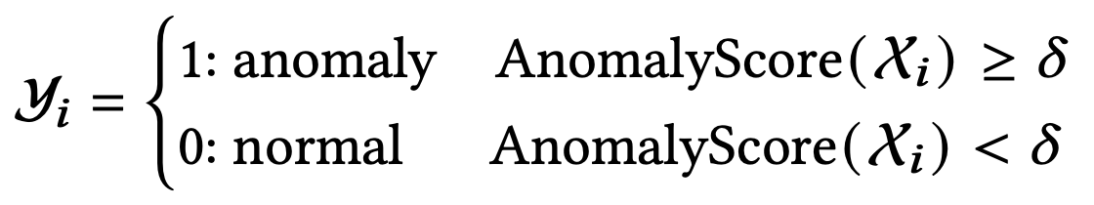
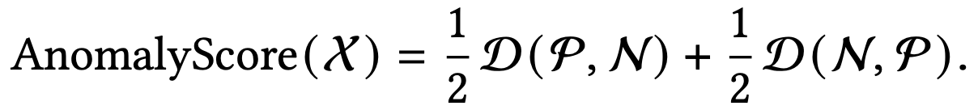
Method: DCdetector's Framework - Representation Discrepancy and Anomaly Detection (3/4, 4/4)
Loss:
Stop-gradient is used to train two branches asynchronously to avoid model collapse
Notes:
Based on the point-wise anomaly score, a hyperparameter threshold delta

Slide 11
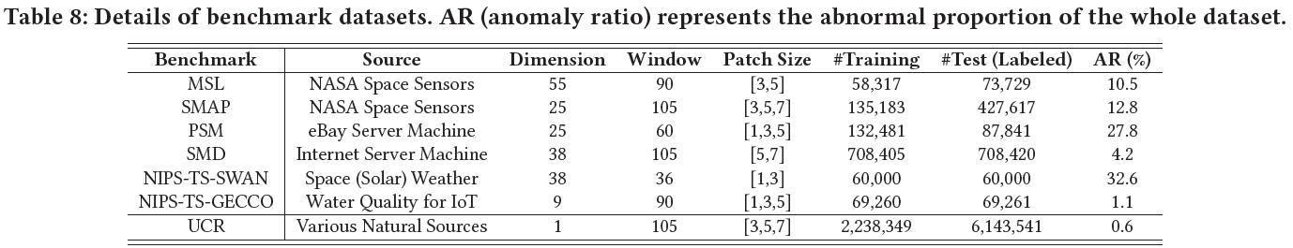
Evaluation: Datasets and Implement (all open-sourced)
Datasets & Baselines
6+1 benchmarks, 26 baselines
Evaluation Criteria
10 metrics (F1, Affiliation, VUS)
Performance on Parameter Sensitivity
Visual Analysis
Time-Cost and Memory Used
One NVIDIA Tesla-V100 32GB GPU
batch size to 128
3 epochs
other hyper-parameters…
Inference time less than 1s for all datasets
All test scripts open source
https://github.com/DAMO-DI-ML/KDD2023-DCdetector

Slide 12
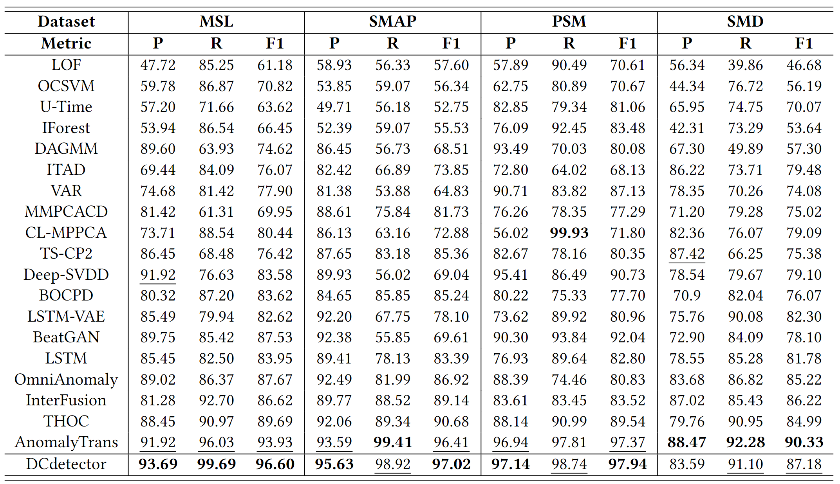
Evaluation: Multivariate Dataset Results

Slide 13
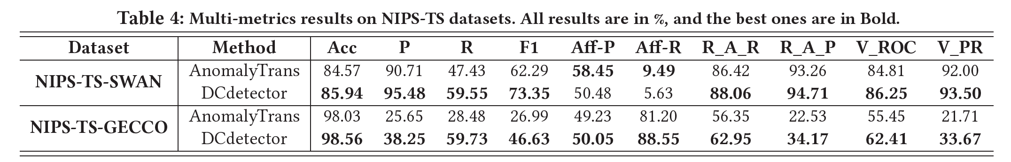
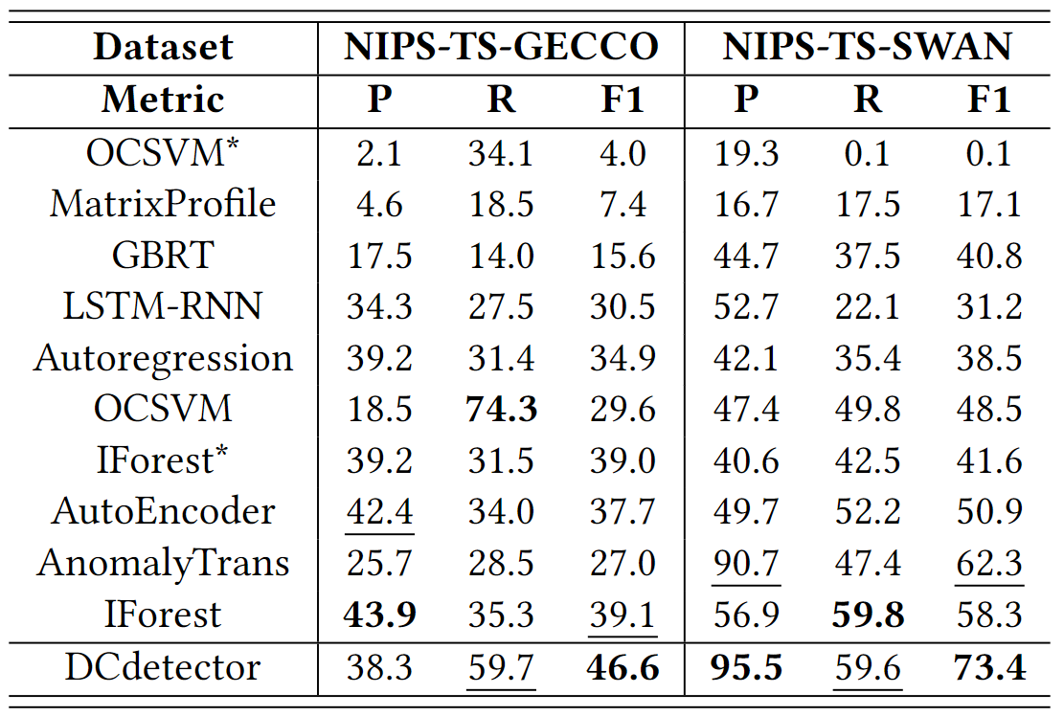
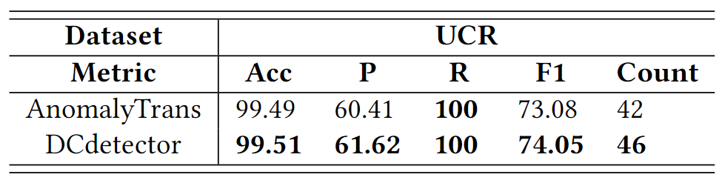
Evaluation: Other Dataset and Evaluation Criteria Results
Overall results on NIPS-TS datasets.
Overall results on univariate dataset.
Alexis Huet, Jose Manuel Navarro, and Dario Rossi. Local Evaluation of Time Series Anomaly Detection Algorithms. KDD’22.
John Paparrizos, Paul Boniol, Themis Palpanas, Ruey S Tsay, Aaron Elmore, and Michael J Franklin. 2022. Volume under the surface: a new accuracy evaluation measure for time-series anomaly detection. VLDB’22

Slide 14
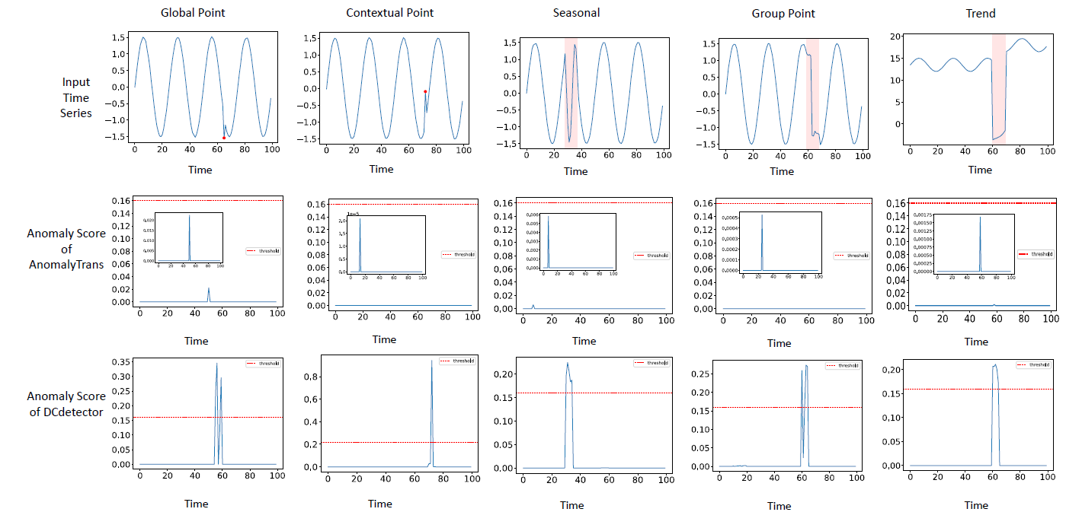
Visualization: To Compare Anomaly Scores under Different Anomaly Types

Slide 15
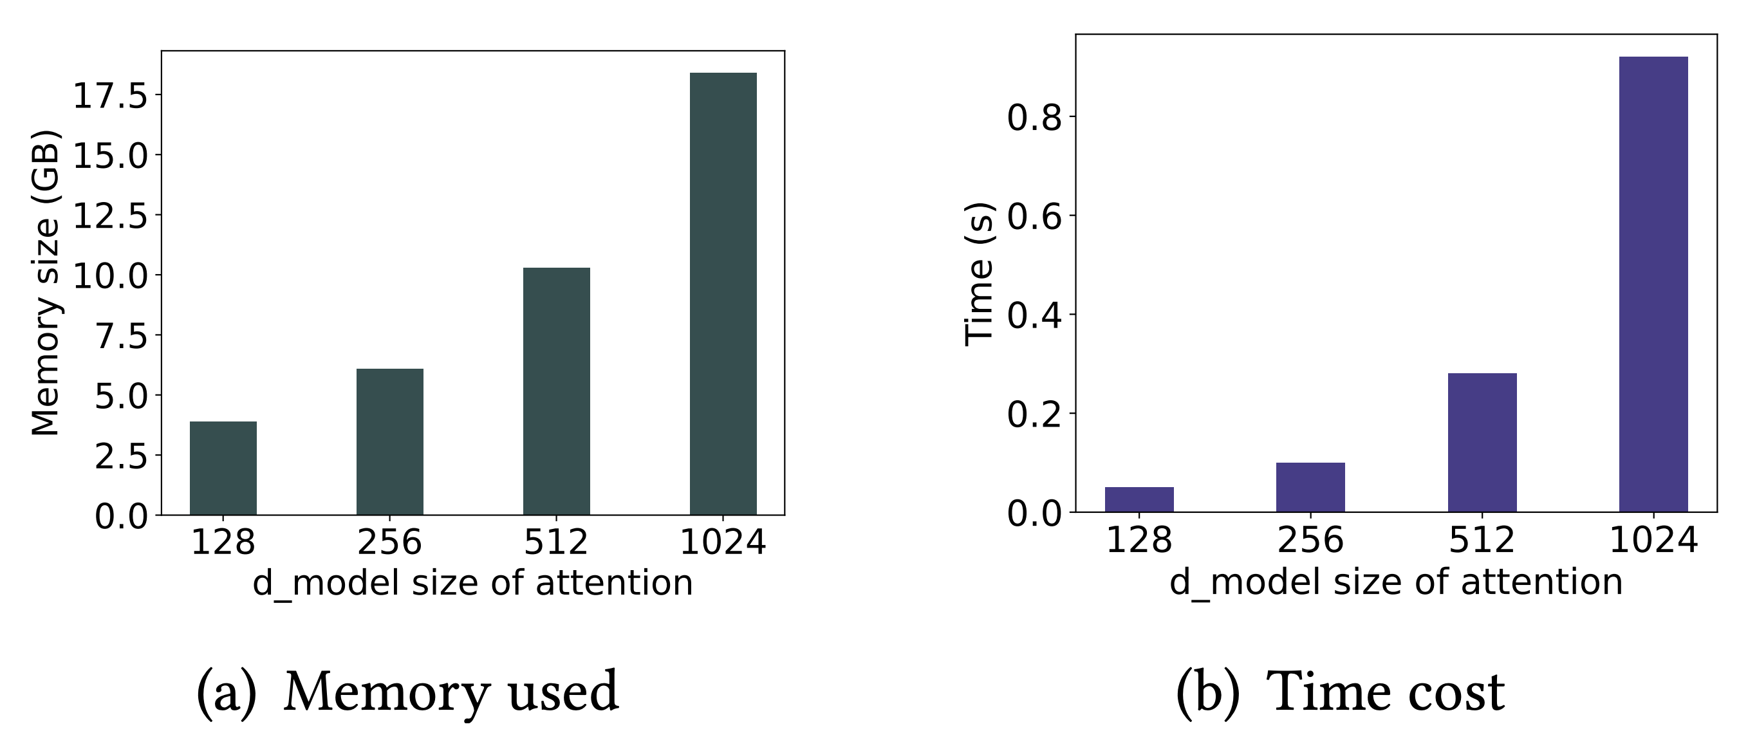
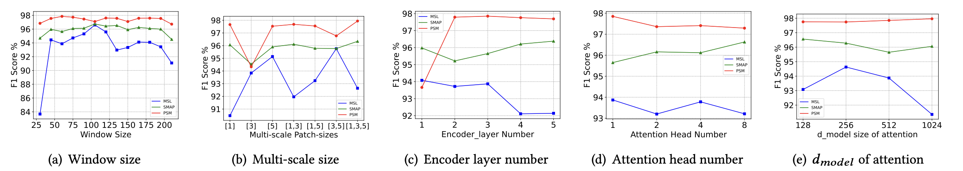
Ablation Experiments and Parameter Sensitivity
Window size
Multi-scale size (patch size)
Encoder layer number & Attention head number
Two branches and single branch
Anomaly threshold
Loss function and Forward process
Other model’s parameter

Slide 16
Conclusion of DCdetector
Architecture:
A contrastive learning-based dual-branch attention structure
Optimization:
An effective loss function is designed based on the similarity of two branches
Model is trained purely contrastively without reconstruction loss, reducing distractions from anomalies
Performance:
DCdetector achieves SOTA performance in 7 benchmarks with 10 metrics, compared with 26 baselines

Slide 17
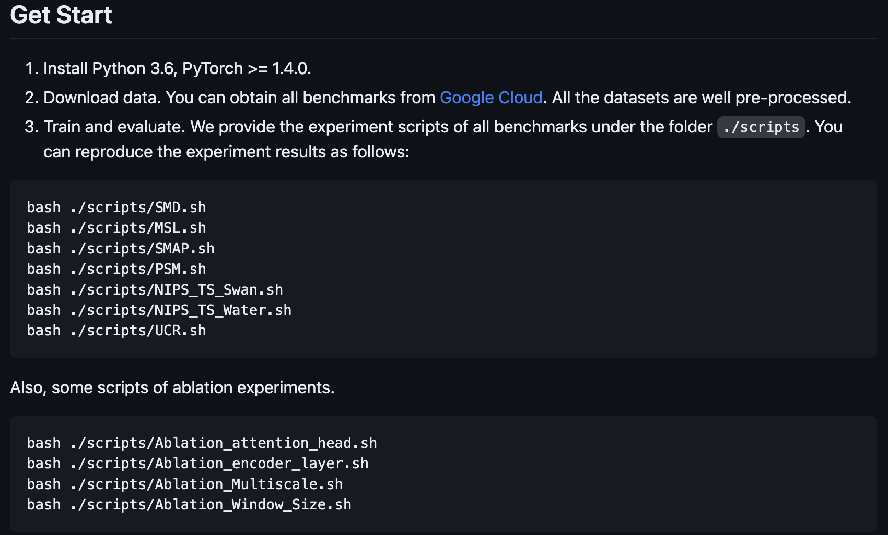
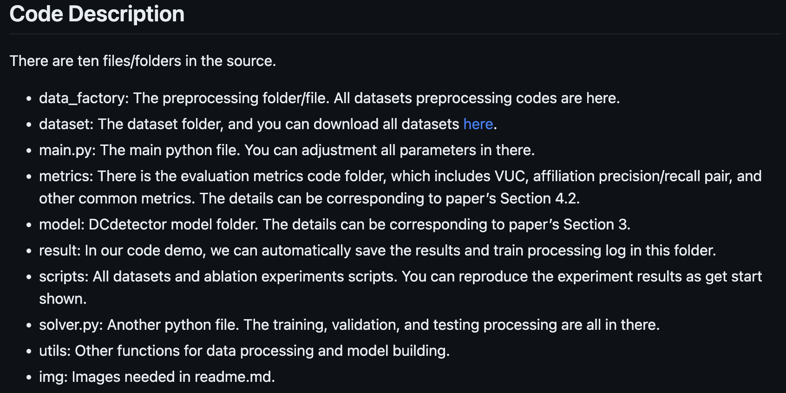
Open-sourced Codes
https://github.com/DAMO-DI-ML/KDD2023-DCdetector

Slide 18
Thanks
Q&A
https://arxiv.org/abs/2306.10347
https://github.com/DAMO-DI-ML/KDD2023-DCdetector

